Slide 1
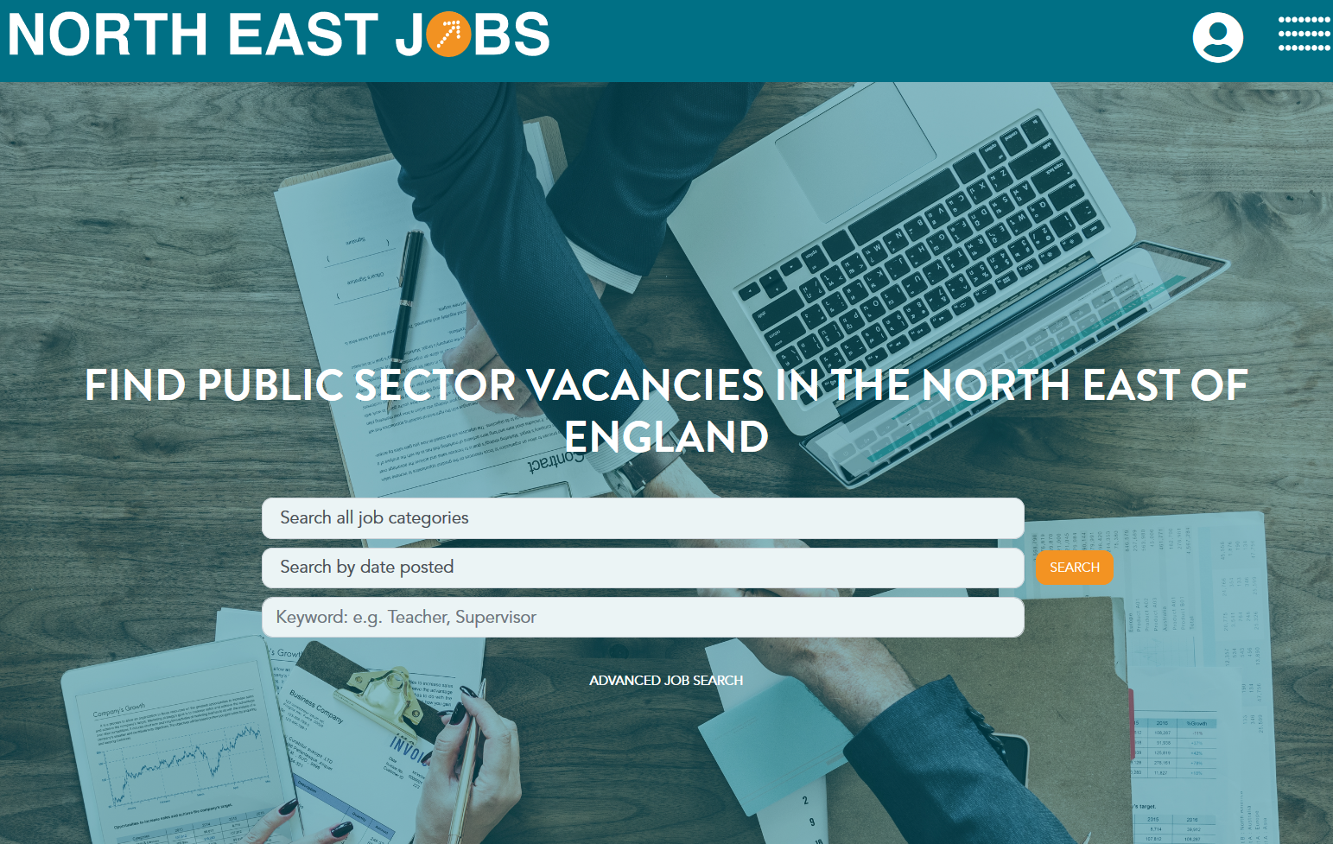

Stephen McCurry
Digital Services Manager

Slide 2
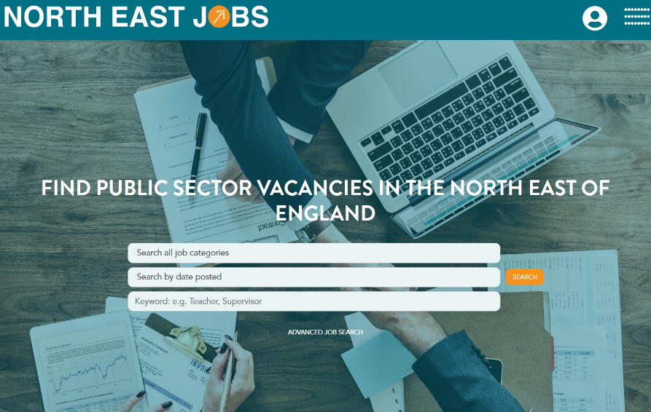
Overview
Launched 2008
12 Local Authorities and many other public sector partners
Grown steadily
In the region of 16,000 vacancies hosted year on year
Housing Associations
Colleges
Supply Agencies
Academies
Over 800 public sector clients
Averages over 360,000 visits each month
Average of 2.64 million pages viewed each month

Slide 3
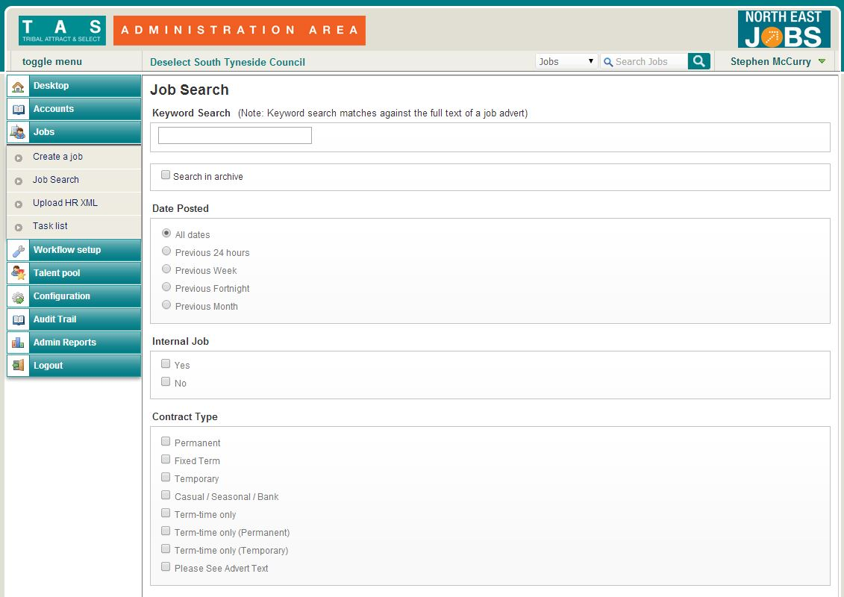
Administration
Advertising facilities
Online Application
Applicant Processing
Online References
Reporting
Integration
Aggregation

Slide 4
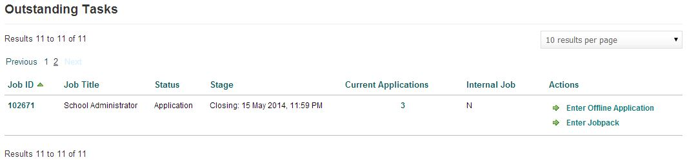
Vacancy Tracking

Slide 5
Workflows
Advert Creation Workflows
Applicant Processing Workflows

Slide 6
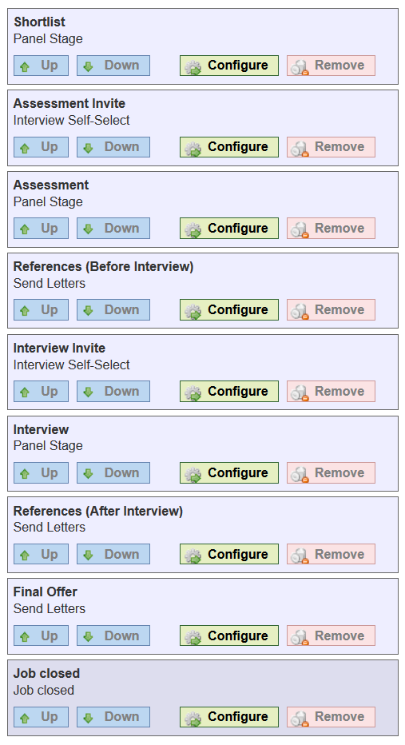
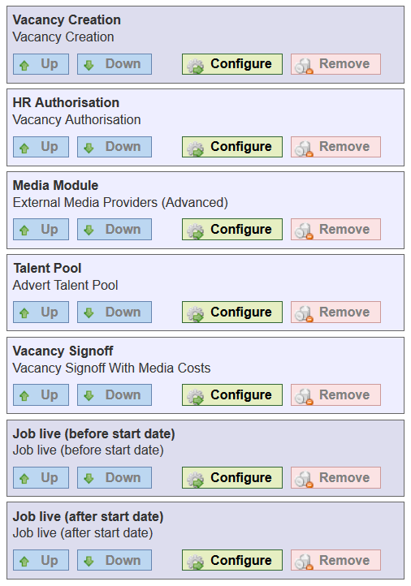

Slide 7
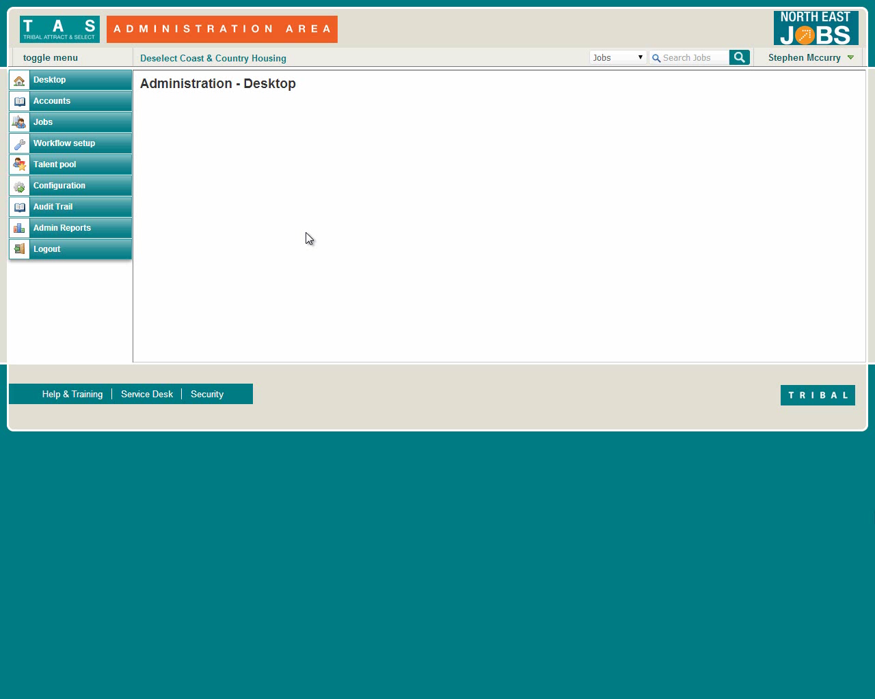
Vacancy Creation

Slide 8
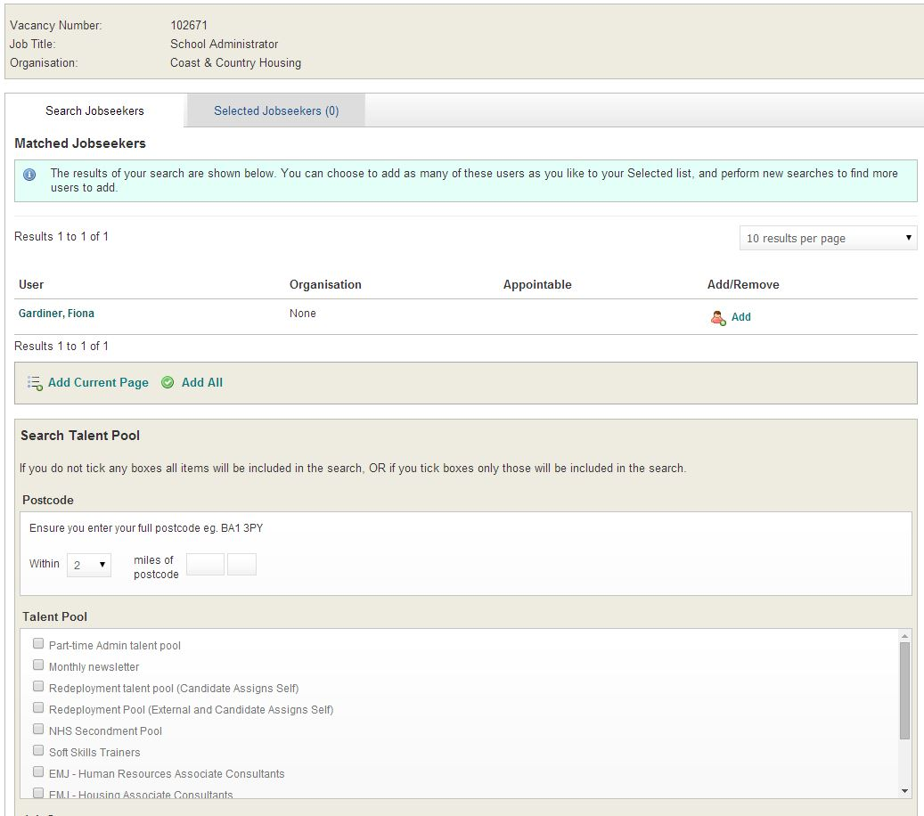
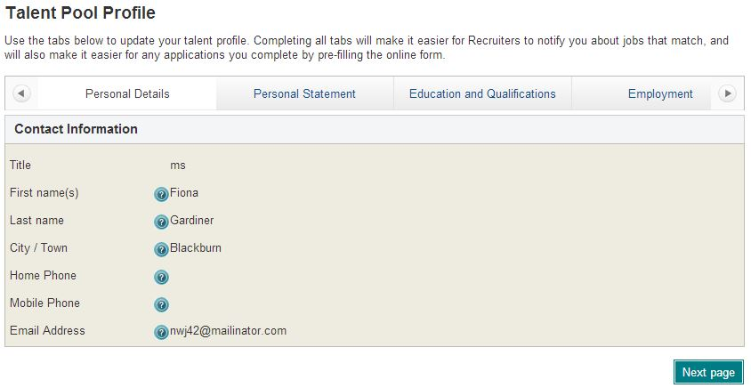
Talent Pool Searches

Slide 9
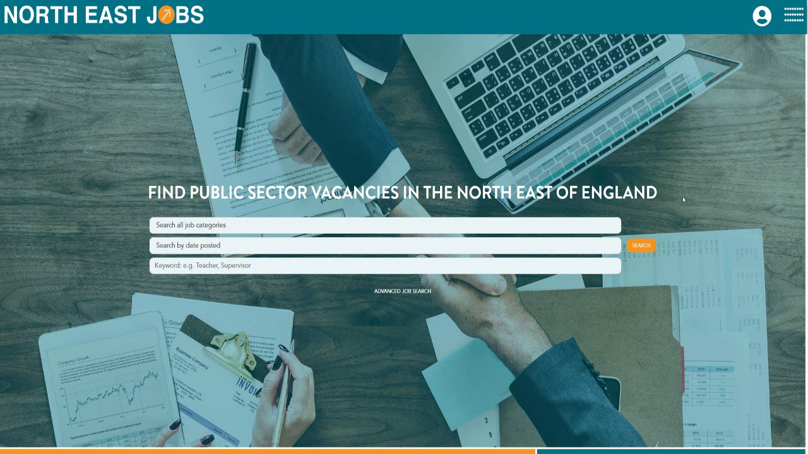
Application

Slide 10
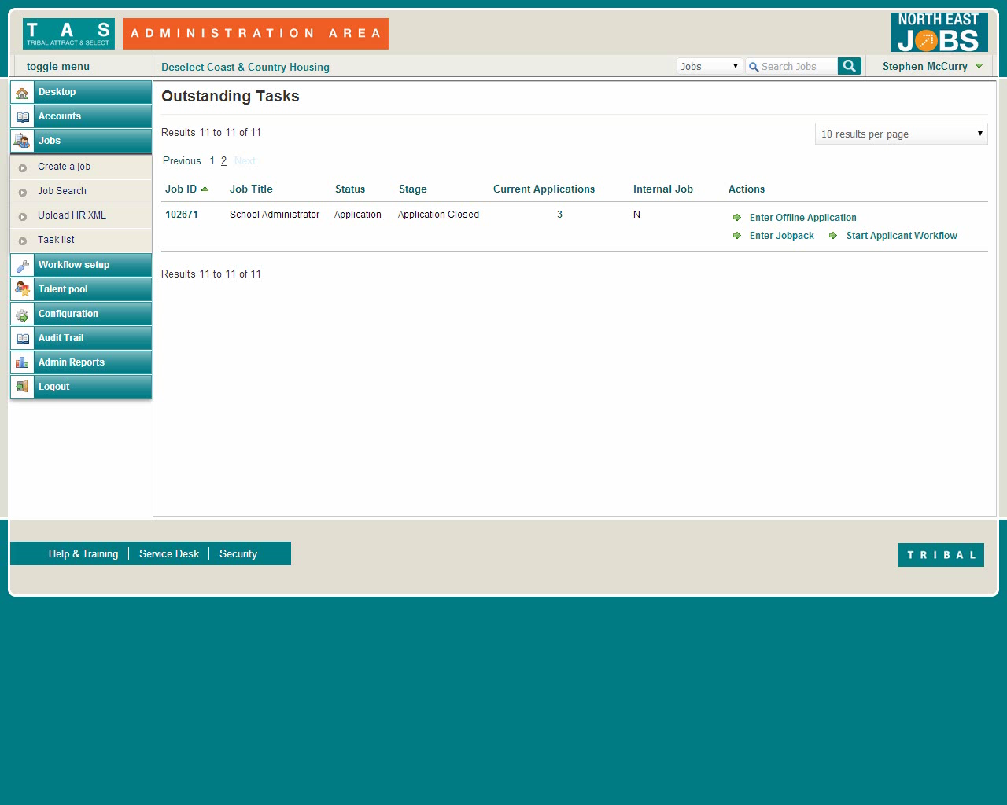
Applicant Scoring

Slide 11
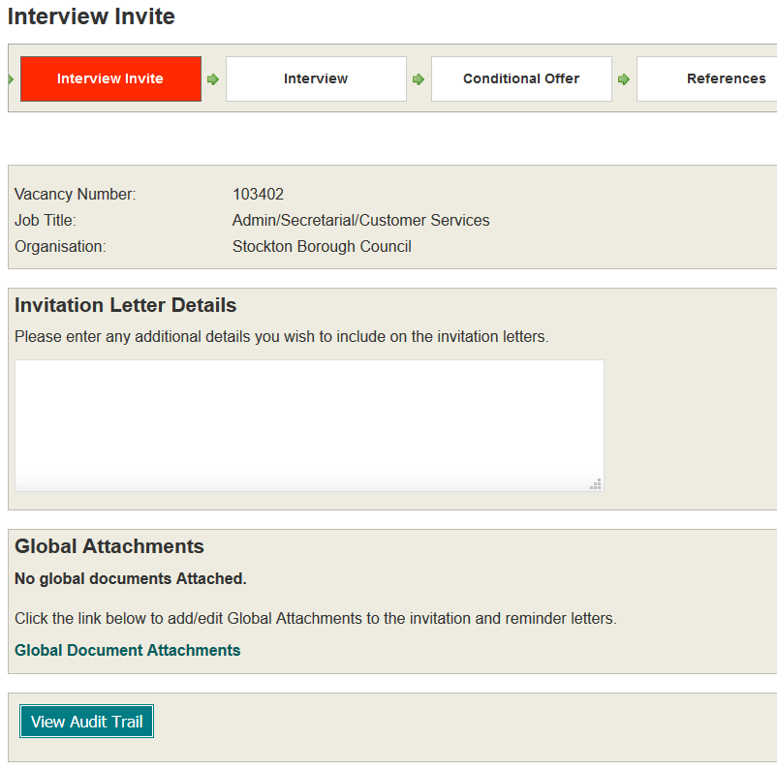
Interview Invites

Slide 12
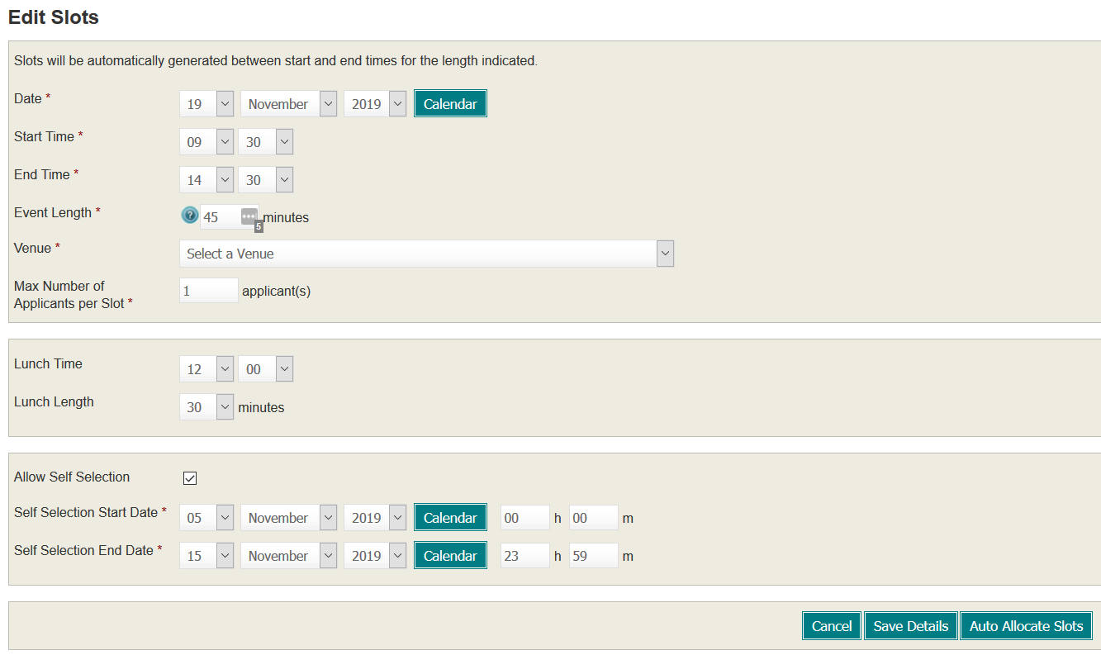
Interview Invites

Slide 13
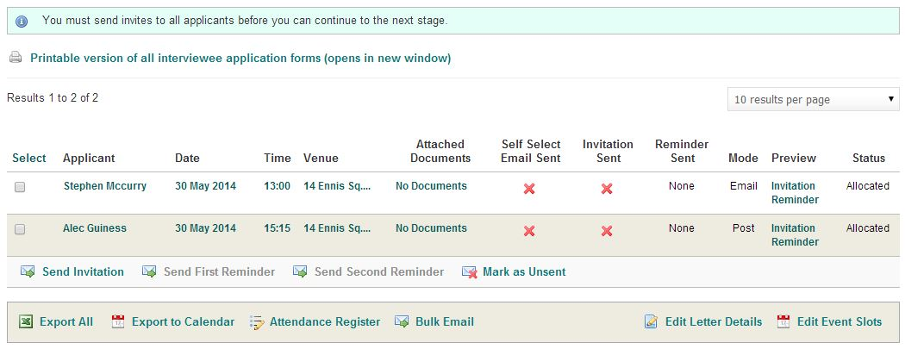
Interview Invites

Slide 14
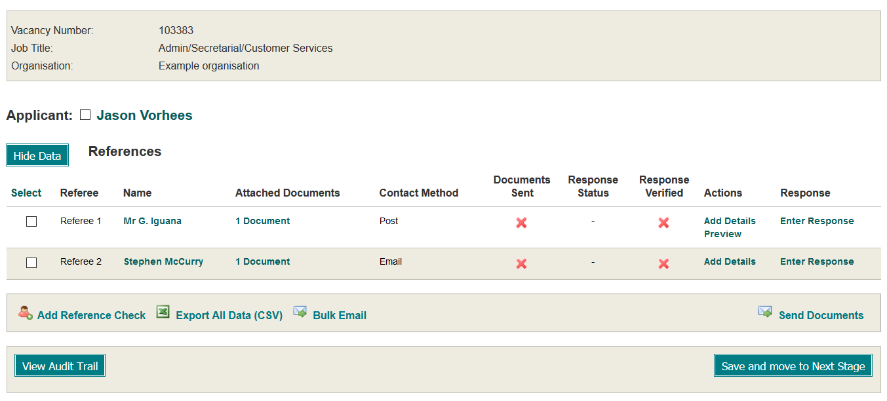
References

Slide 15
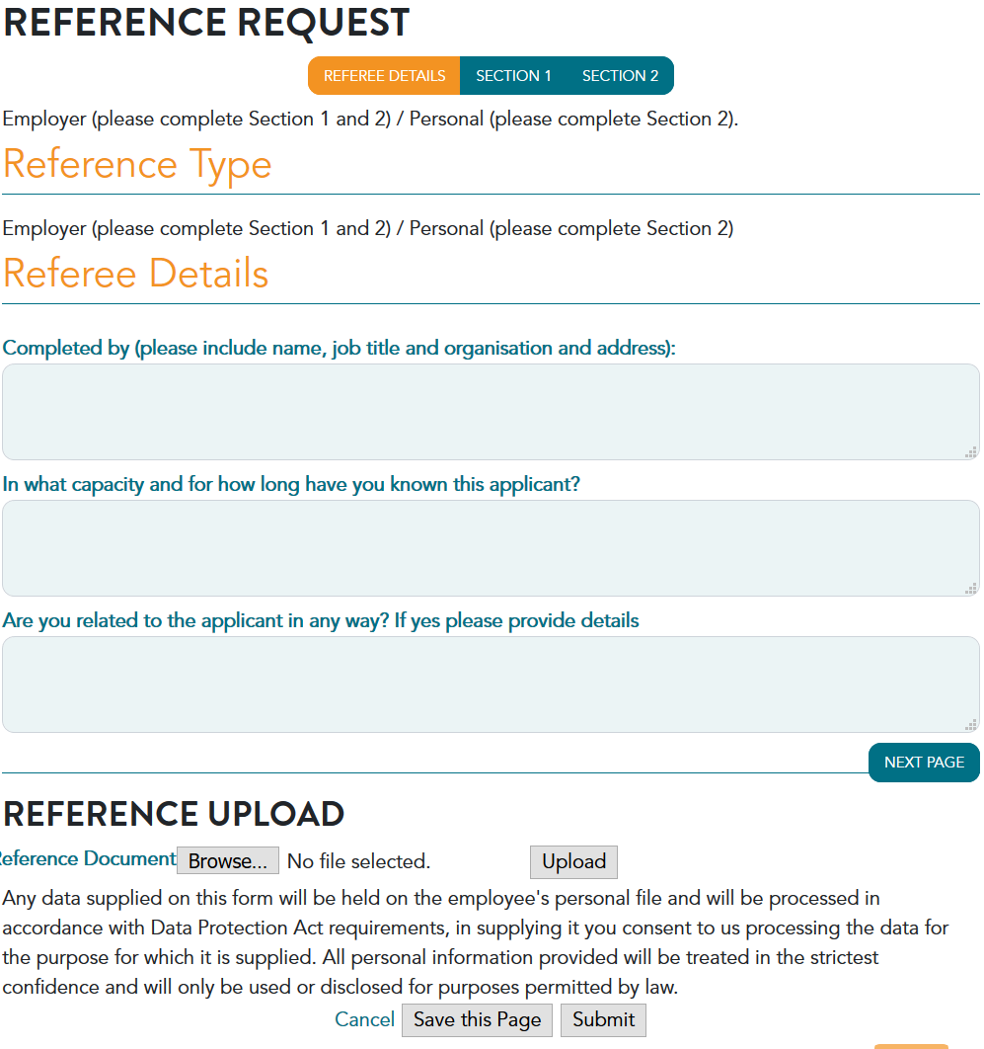
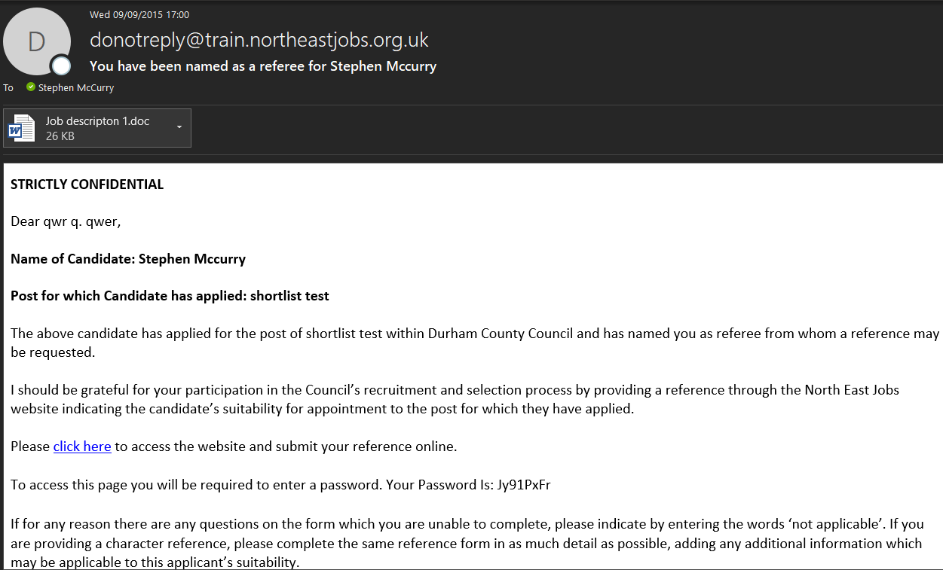
References

Slide 16
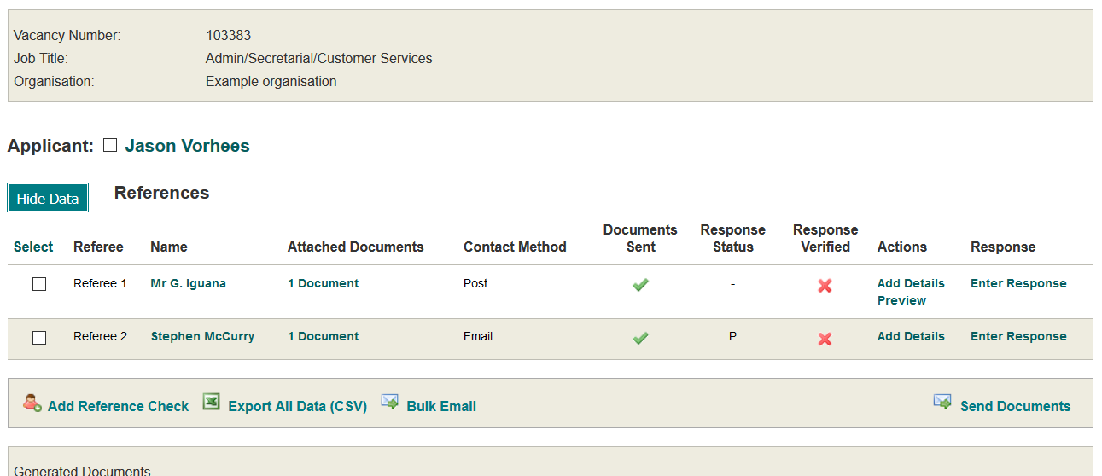
References

Slide 17
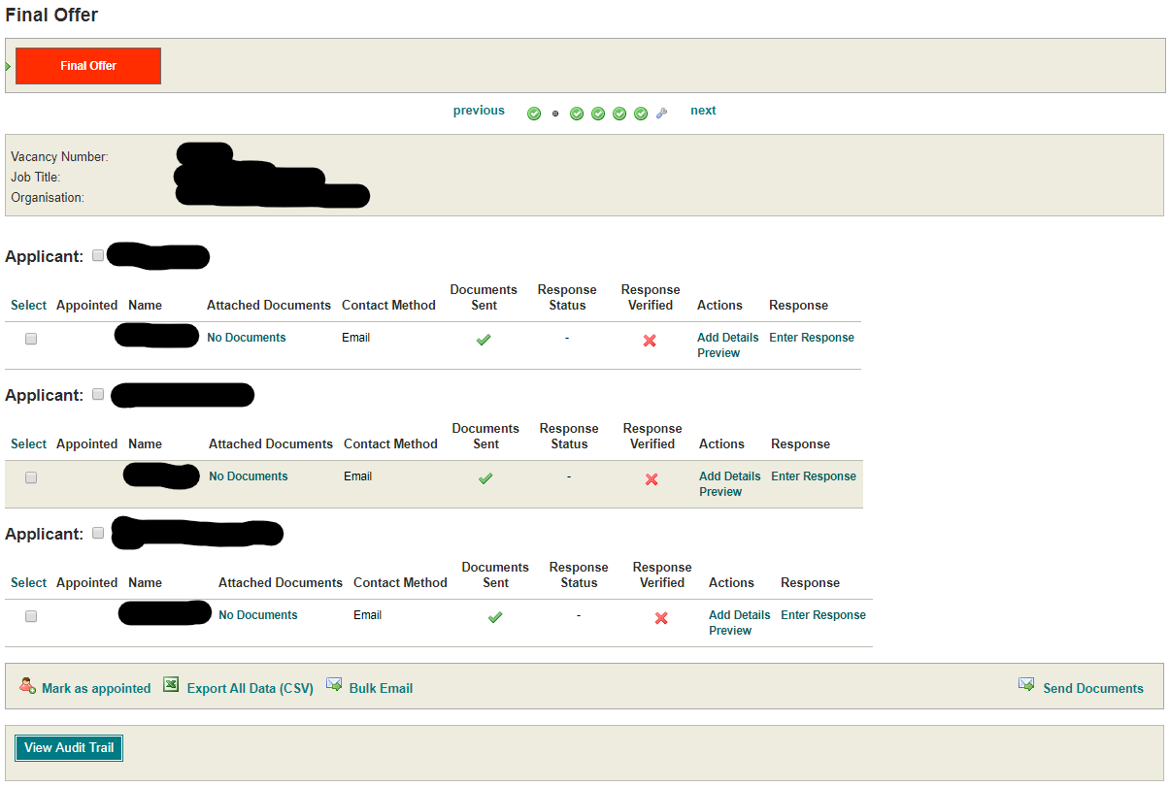
Offer Letters

Slide 18
Setup and Training
All provided by NEREO
Custom Workflows / Forms
Full Training
Manuals and Online Training
Support

